Slide 1
Web Services @UCAR
Markus Stobbs
Web Engineering Group
Notes:
Talk was originally titled SOA, changed title to focus on the Web Services approach to SOA.

Slide 2
Overview
SOA and Web Services
Consuming RESTful web services
UCAR Web Services Sampler
Building a Web Service

Slide 3
Service Oriented Architecture (SOA)
Design and develop software using loosely-coupled, interoperable services

Slide 4
Web Services
An approach to SOA that uses standard Internet protocols
Simple Object Access Protocol (SOAP) services implement their own methods and use XML data format
Representational State Transfer (REST) services use HTTP methods (GET, PUT, POST, DELETE) and often use JSON data format
Notes:
SOAP was successor to XML-RPC

Slide 5
REST client-server interaction
client
http
1. Client provides URI
3. JSON data
returned to client
2. Service interprets URI, queries data source, builds response
REST web service
DB

Slide 6
REST Contraints
Client-server
Stateless
Cacheable
Layered system
Uniform interface

Slide 7
REST Principles
Identification of resources (URI)
Manipulation of resources
Self-descriptive messages

Slide 8
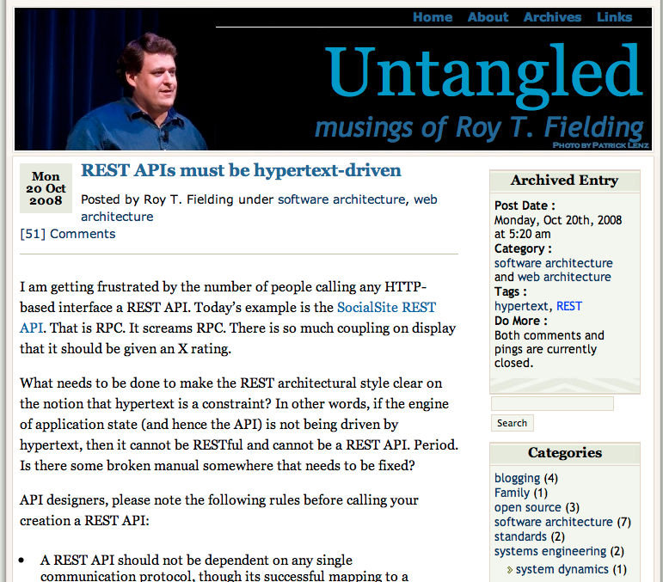

Slide 9
URI
https://people.api.ucar.edu/persons/mstobbs
https://people.api.ucar.edu/subOrgs?org=cisl
protocol
server
service
argument
service
argument(s)

Slide 10
JSON
JavaScript Object Notation
Standard data interchange format
Lightweight, human-readable
Language-independent
Parsers available in most languages
Simpler than XML

Slide 11
{
"firstName": "John",
"lastName" : "Smith",
"age" : 25,
"address" :
{
"streetAddress": "21 2nd Street",
"city" : "New York",
"state" : "NY",
"postalCode" : "10021"
},
"phoneNumber":
[
{
"type" : "home",
"number": "212 555-1234"
},
{
"type" : "fax",
"number": "646 555-4567"
}
]
}

Slide 12
Without JSON View
https://people.api.ucar.edu/persons/mstobbs
{"upid":296,"uid":"2794","firstName":"Mark","lastName":"Stobbs", "preferredName":"Markus","email":"mstobbs@ucar.edu","forwardEmail": "mstobbs@mail.ucar.edu","homePage":"http:\/\/www.cisl.ucar.edu\/staff\/mstobbs\/","username":"mstobbs","active":true,"usernameStatus":"active", "lastChanged":"1320080349","phone":"303-497-1238","location":"ML-17L", "internalOrg":"OSD","mailStop":"CISL","country":"United States"}

Slide 13

https://people.api.ucar.edu/persons/mstobbs
{
upid: 296,
uid: "2794",
firstName: "Mark",
lastName: "Stobbs",
preferredName: "Markus",
email: "mstobbs@ucar.edu",
forwardEmail: "mstobbs@mail.ucar.edu",
homePage: "http://www.cisl.ucar.edu/staff/mstobbs/",
username: "mstobbs",
active: true,
usernameStatus: "active",
lastChanged: "1320080349",
phone: "303-497-1238",
location: "ML-17L",
internalOrg: "OSD",
mailStop: "CISL",
country: "United States"
}

Slide 14
https://people.api.ucar.edu/subOrgs?org=cisl
[
{
"orgId": 119,
"acronym": "OSD",
"active": true,
"name": "Operations and Services Division",
"level": "Division / Section",
"levelCode": "0700",
"leadUpid": 16511,
"parentOrgAcronym": "CISL",
"authoritativeUpid": 4760
},
{
"orgId": 146,
"acronym": "TDD",
"active": true,
"name": "Technology Development Division",
"level": "Division / Section",
"levelCode": "0700",
"leadUpid": 993,
"parentOrgAcronym": "CISL",
"authoritativeUpid": 4760
},
{
"orgId": 81,
"acronym": "IMAGe",
"active": true,
"name": "Institute for Mathematics Applied to the Geosciences",
"level": "Division / Section",
"levelCode": "0700",
"leadUpid": 444,
"parentOrgAcronym": "CISL",
"authoritativeUpid": 11315
},
{
"orgId": 33,
"acronym": "CISLAO",
"active": true,
"name": "CISL Administrative Office",
"level": "Division / Section",
"levelCode": "0700",
"leadUpid": 8923,
"parentOrgAcronym": "CISL",
"authoritativeUpid": 4760
}
]

Slide 15
REST Client Toolkit
JSONView browser plugin
HTTP client library
JSON parser library

Slide 16
PHP code example
<?php
$response = http_get("https://people.api.ucar.edu/
internalPersons?name=bob" , $info);
$body = http_parse_message($response)->body;
$persons = json_decode($body);
foreach ($persons as $person) {
foreach ($person as $key => $value) {
echo nl2br("$key: $value \n");
}
echo nl2br("\n");
}
?>
Notes:
3. Do an http get, 6. extract the body of the http request, 8. decode the json, 10. loop through my data array printing key/value pairs.

Slide 17
Python code example
#!/usr/bin/python
import httplib2
import demjson
url='https://people.api.ucar.edu/internalPersons?name=bill'
http=httplib2.Http()
headers = {'Content-type': 'application/json'}
response, content = http.request(url, 'GET', headers=headers)
status = response.status
if status == 200:
persons=demjson.decode(content)
for i in range(len(persons)):
for key, value in persons[i].items():
print "%s=%s" % (key, value)
print
if status == 399:
print content
if status == 500:
print 'Server error'

Slide 18
Perl code example
#!/usr/bin/perl
use LWP::UserAgent;
use JSON;
$url='https://people.api.ucar.edu/internalPersons?name=bob';
$ua = LWP::UserAgent->new;
$ua->agent("MyApp/0.1 ");
my $req = HTTP::Request->new(GET => $url);
$req->content_type('application/json');
my $res = $ua->request($req);
if ($res->is_success) {
#print $res->content;
$respData=from_json($res->content);
#use Data::Dumper; die(Dumper($respData));
foreach my $hash (@{$respData}) {
#use Data::Dumper; print Dumper($hash);
while( my($key, $value) = each %{$hash} ){
print "$key: $value\n";
}
print "\n";
}
}
elsif ($res->code eq "399" )
{
print $res->content, "\n";
}
else
{
print $res->status_line, "\n";
}

Slide 19
Java code example
package edu.ucar.cisl.ds.client;
import java.io.BufferedReader;
import java.io.IOException;
import java.io.InputStream;
import java.io.InputStreamReader;
import java.net.MalformedURLException;
import java.net.URL;
import javax.net.ssl.HostnameVerifier;
import javax.net.ssl.HttpsURLConnection;
import javax.net.ssl.SSLContext;
import javax.net.ssl.SSLSession;
import javax.net.ssl.TrustManager;
import javax.net.ssl.X509TrustManager;
import org.codehaus.jettison.json.JSONArray;
import org.codehaus.jettison.json.JSONException;
import org.codehaus.jettison.json.JSONObject;
public class DsClient2 {
protected static boolean initialized=false;
protected static String host="https://people.api.ucar.edu/";
static public void setup() throws DsClientException
{
TrustManager[] trustAllCerts = new TrustManager[] { new X509TrustManager() {
public java.security.cert.X509Certificate[] getAcceptedIssuers() {
return null;
}
public void checkClientTrusted(java.security.cert.X509Certificate[] certs, String authType) {
}
public void checkServerTrusted(java.security.cert.X509Certificate[] certs, String authType) {
}
} };
// Install the all-trusting trust manager
try {
SSLContext sc = SSLContext.getInstance("SSL");
sc.init(null, trustAllCerts, new java.security.SecureRandom());
HttpsURLConnection.setDefaultSSLSocketFactory(sc.getSocketFactory());
} catch (Exception e) {
//logger.error("Error in init SSL Context.", e);
throw new DsClientException("Error in init SSL Context.", e);
}
HostnameVerifier hv = new HostnameVerifier() {
public boolean verify(String urlHostName, SSLSession session) {
return true;
}
};
HttpsURLConnection.setDefaultHostnameVerifier(hv);
initialized = true;
}
public void invokeREST(String url) throws DsClientException
{
setup();
try
{
URL u = new URL(url);
HttpsURLConnection uc = (HttpsURLConnection) u.openConnection();
uc.setRequestMethod("GET");
uc.setRequestProperty("Content-Type", "application/xml");
uc.setDoOutput(false);
int status = uc.getResponseCode();
if (status != 200) {
if (status == 401)
throw new DsClientException("Invalid login/password to connect to auth service server");
if (status == 399)
{
InputStream in = uc.getInputStream();
BufferedReader d = new BufferedReader(new InputStreamReader(in));
String buffer = d.readLine();
throw new DsClientException("Server error: " + buffer);
}
}
InputStream in = uc.getInputStream();
BufferedReader d = new BufferedReader(new InputStreamReader(in));
String buffer = d.readLine();
parseJson(buffer);
}
catch (MalformedURLException me)
{
me.printStackTrace();
}
catch (IOException ioe)
{
ioe.printStackTrace();
}
catch (JSONException jsoe)
{
jsoe.printStackTrace();
}
}
protected void parseJson(String content) throws JSONException
{
JSONArray ja=new JSONArray(content);
for (int i=0; i<ja.length(); i++)
{
JSONObject jo=ja.getJSONObject(i);
System.out.println("upid: " + jo.getString("upid"));
System.out.println("firstName: " + jo.getString("firstName"));
System.out.println("lastName: " + jo.getString("lastName"));
System.out.println("middleName: " + jo.getString("middleName"));
System.out.println("nickname: " + jo.getString("nickname"));
System.out.println("nameSuffix: " + jo.getString("nameSuffix"));
System.out.println("username: " + jo.getString("username"));
System.out.println("email: " + jo.getString("email") + "\n");
}
}
public void searchInternalPersons(String name, String phoneNumber, String email) throws DsClientException
{
setup();
String url = host + "/internalPersons?";
if (name != null)
url= url + "name=" + name;
if (phoneNumber != null)
url= url + "&phoneNumber=" + phoneNumber;
if (email != null)
url= url + "&email=" + email;
invokeREST(url);
}
public static void main(String args[]) {
try
{
DsClient2 client=new DsClient2();
client.searchInternalPersons("sun", null, null);
}
catch (DsClientException ex)
{
System.out.println(ex.getMessage());
Exception e=ex.getException();
if (e != null)
e.printStackTrace();
}
}
}

Slide 20

UCAR Web Services Sampler

Slide 21
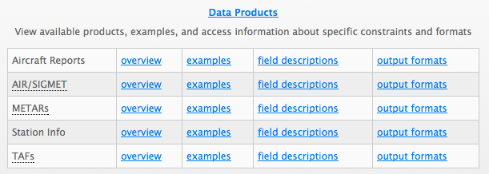
RAL Web Services
Aviation Digital Data Service (weather.aero)
RESTful
Icing reports
Pilot reports
Visualization
1 million hits/day from 12,000 unique IPs

Slide 22
Aircraft Report XML sample
<response xmlns:xsd="http://www.w3.org/2001/XMLSchema" xmlns:xsi="http://www.w3.org/2001/XML-Schema-instance" version="1.0"xsi:noNamespaceSchemaLocation="http://weather.aero/schema/aircraftreport1_0.xsd">
<request_index>11064672</request_index>
<data_source name="aircraftreports"/>
<request type="retrieve"/>
<errors/>
<warnings/>
<time_taken_ms>17</time_taken_ms>
<data num_results="30">
<AircraftReport>
<receipt_time>2012-02-23T00:46:29Z</receipt_time>
<observation_time>2012-02-23T00:43:00Z</observation_time>
<quality_control_flags>
<no_flt_lvl>TRUE</no_flt_lvl>
</quality_control_flags>
<aircraft_ref>B190</aircraft_ref>
<latitude>49.7167</latitude>
<longitude>-124.8228</longitude>
<altitude_ft_msl>5500</altitude_ft_msl>
<turbulence_condition turbulence_intensity="LGT-MOD" turbulence_base_ft_msl="3000"
turbulence_top_ft_msl="8000"/>
<report_type>PIREP</report_type>
<raw_text>
VR UA /OV CYQQ 090003 /TM 0043 /FLUNKN /TP B190 /TB LGT-MDT 080-030
</raw_text>
</AircraftReport>

Slide 23

RAL Web Services
Next Generation Network Enabled Weather
SOAP
4-D Weather Data Cube
NCAR, FAA, NOAA, MIT Lincoln Lab collaboration
Weather data distribution for aviation
Software distributed to a dozen other data providers
Dataset replication between servers
nnew.aero
wiki.ucar.edu/display/NNEWD

Slide 24
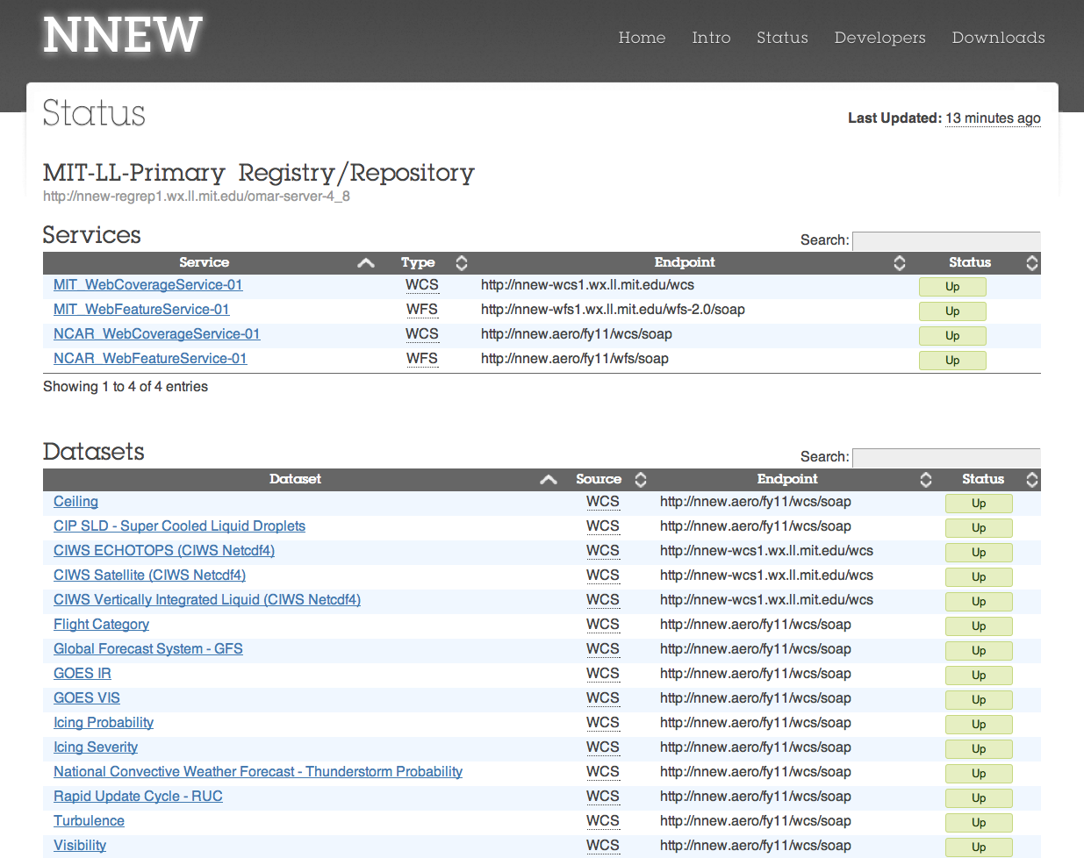

Slide 25
RAL Web Services
GIS
Web Map Service (JPEG)
www.gis.ucar.edu/maps_wcs_climate.jsp
Web coverage (GeoTiff, netCDF)
www.gis.ucar.edu/maps_wcs_climate.jsp
In Development
Distributing CCSM AR4 raw data and data products via RESTful web service
Download shape, text or image files
Launching in a couple months at www.gisclimatechange.org

Slide 26
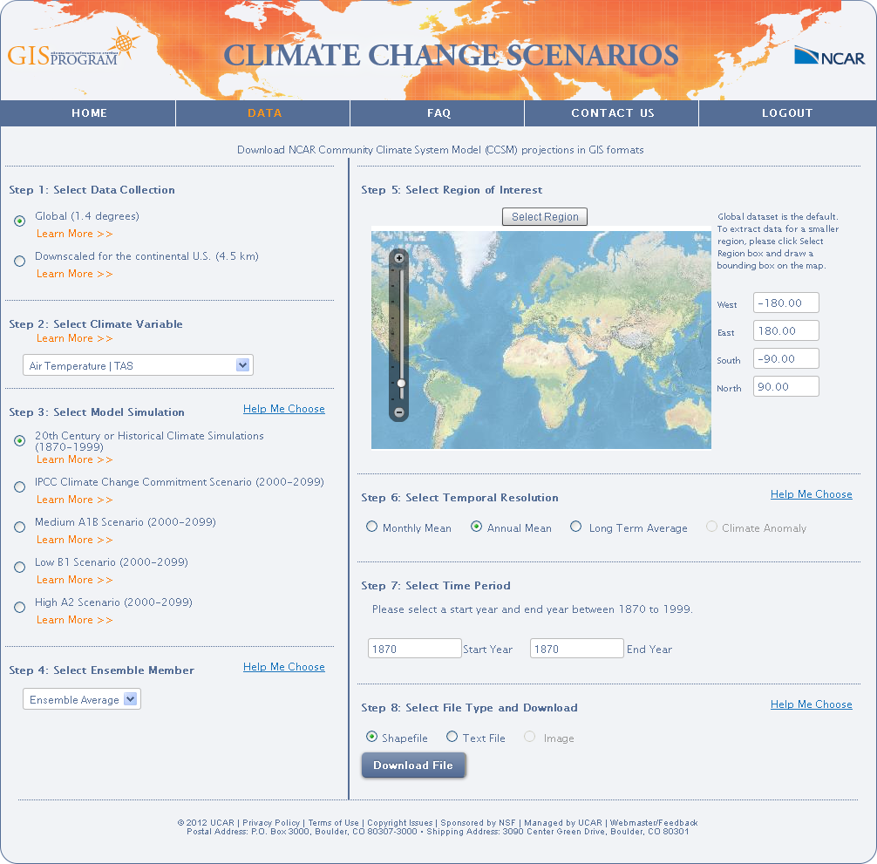
Notes:
Folks can get global 1.4 degree CCSM monthly mean data for AR4 and 4.5 km downscaled data for the continental US. They can access the raw CCSM monthly mean data, or the new derived products (long term averages (2030, 2050, 2090), climate change anomalies (difference maps for those same three times, and annual means. they can get the data as a shapefile, textfile, or image.

Slide 27
NSDL Web Services
Strand Map Service
Generate knowledge maps
JavaScript API
CSIP REST API
strandmap.nsdl.org

Slide 28
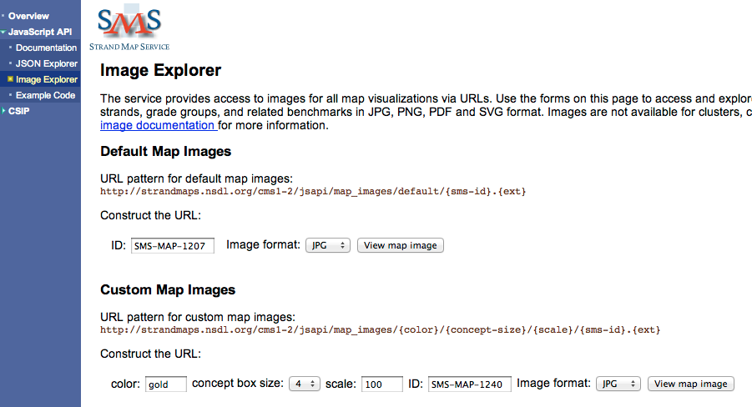

Slide 29
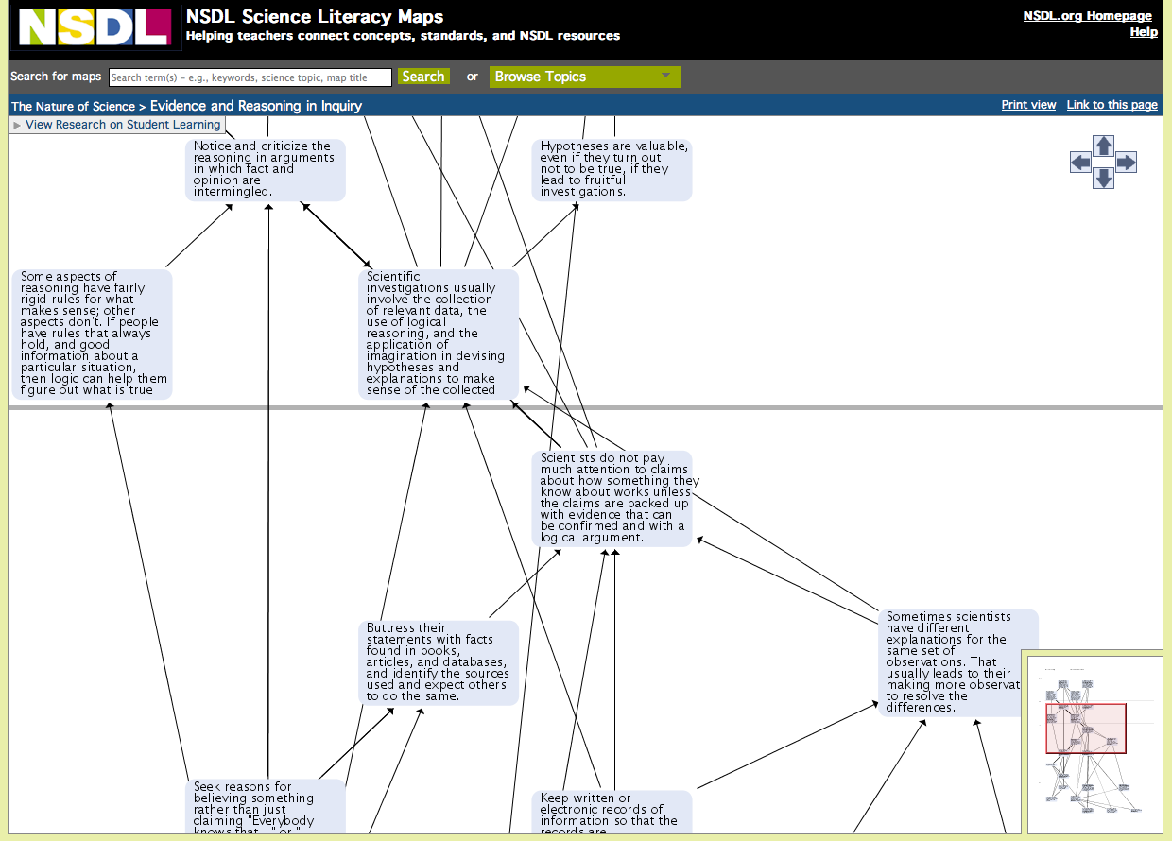

Slide 30
NSDL Web Services
NSDL Search API (REST-RPC hybrid)
Repository Update Service API
NSDL OAI Data Provider
CCS – Mashup of services for creating digitized curriculums

Slide 31
DLESE Web Services
Search Search API (REST-RPC hybrid)
Repository Update Service API
JavaScript Search Service

Slide 32
NCAR Library OpenSky Web Services
Service integration with web pages
opensky.library.ucar.edu/webservices
Search Service API (RESTful)
nldr.library.ucar.edu/dds/services/ddsws1-1/index.jsp

Slide 33
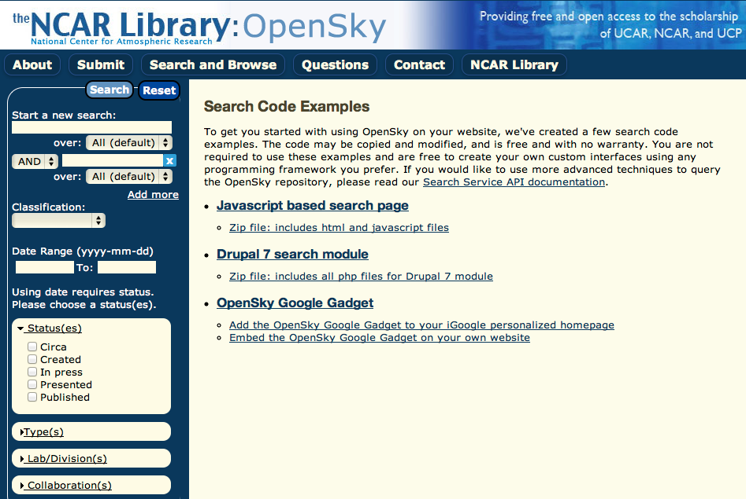

Slide 34
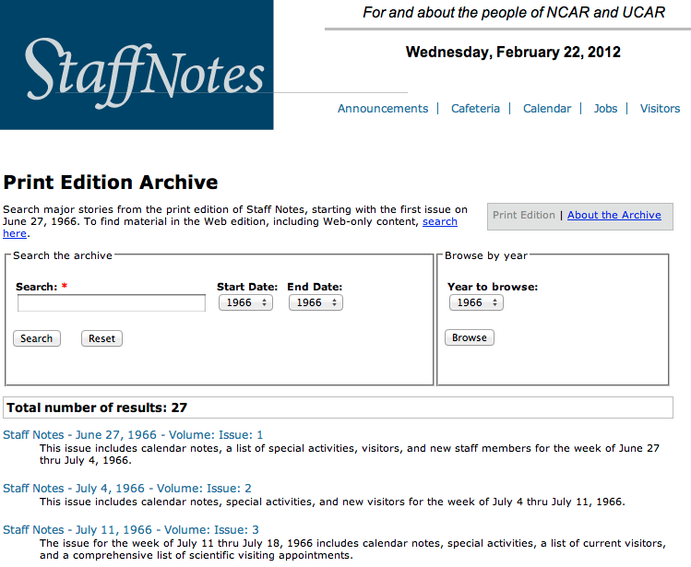
StaffNotes OpenSky Search

Slide 35
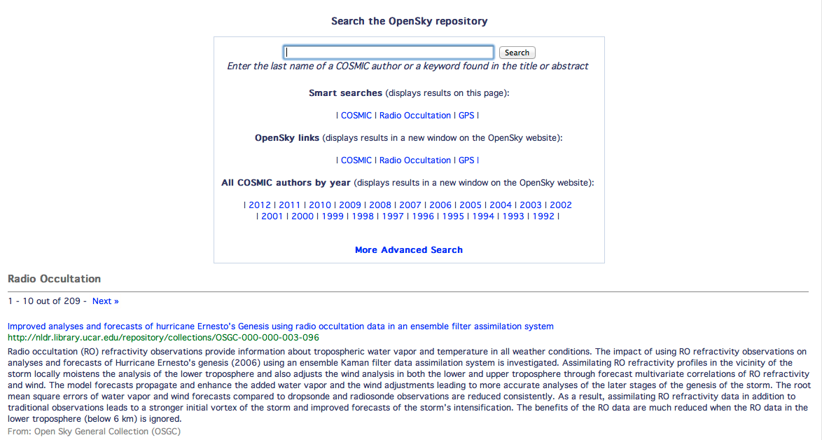
COSMIC OpenSky Search

Slide 36
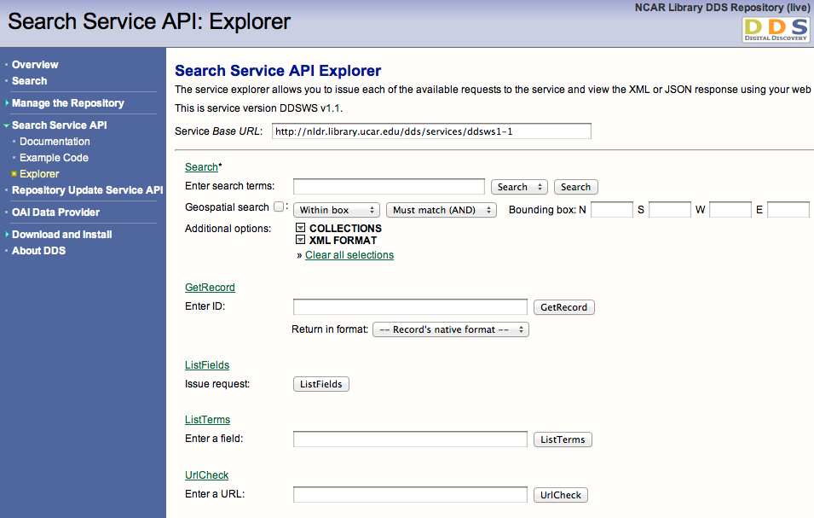

Slide 37
F&A Web Services
iVantage SOAP service (PDB integration)
Planned
Travel Authorization/IFAS
OnBoarding/Silk Road

Slide 38


Unidata Web Services
THREDDS Data Server (TDS)
NetCDF Subset Service (RESTful)
OPeNDAP client
CDM remote web service client
and more…
www.unidata.ucar.edu/projects/THREDDS/tech/TDS.html
RAMADDA
Content repository and publishing system
Data source for IDV

Slide 39
WEG Web Services
Auth REST API
People REST API

Slide 40
Auth REST API
Convenience layer for adding authentication to your applications
No need to deal with technical particulars of authentication backends
Java client packages available
UCAS Password (Kerberos) authentication
Kerberos passphrase expiration date
UCAS Token (Radius) authentication

Slide 41
Java auth client code example
import edu.ucar.cisl.authenticator.client.AuthClient;
import edu.ucar.cisl.authenticator.client.AuthClientException;
import edu.ucar.cisl.authenticator.domain.Authentication;
try {
Authentication auth=AuthClient.getAuthentication("password", "bsun", "bsun");
//Authentication auth=AuthClient.getAuthentication("token", "bsun", "261-3394");
System.out.println("result is " + auth.isValid());
if (auth.isValid()) {
System.out.println("First Name is " + auth.getFirstName());
System.out.println("Last Name is " + auth.getLastName()); }
}
catch (AuthClientException ex) {
System.out.println(ex.getMessage());
Exception e=ex.getException();
if (e != null)
e.printStackTrace();
}

Slide 42
People REST API
People
Staff
Visitors
Collaborators
Usernames (uid)
Groups (gid)
UCAR and External Orgs

Slide 43
Authoritative data sources
People DB
upid, username, nickname, non-office phones
HR iVantage DB
Internal persons: names, position, status
Organization structure
NETS DB
Internal persons: office allocations, preferred names
CISL HPC Allocations DB(ACC8->SAM)
Supercomputing and TeraGrid users

Slide 44
People DB Architecture
apps
scripts
CISL
HR
NETS
Your DB
LDAP
People REST API
Synchronizer
People DB

Slide 45
Example uses of People DB
Use orgs service to create cascade drop down menus
Add people search widget to your site or list a directory of your staff
Populate user profile at initial authentication
Authorization of users using groups service or LDAP integration

Slide 46
SQL vs. REST search internal persons
SELECT P.name_last, P.name_first, P.email, P.upid,
P.name_middle,
P.name_suffix,
P.nickname
FROM person P
WHERE to_lower(P.name_first) like ‘%mark%’ or to_lower(P.name_last) ilike ‘%mark%’ or to_lower(P.name_middle) like ‘%mark%’ or to_lower(P.name_first) like ‘%mark%’;
https://people.api.ucar.edu/internalPersons?name=markus

Slide 47
SQL vs. REST get staff detail
SELECT P.name_last, P.name_first, P.email, P.upid,
C.position_current_id,
C.current_employee,
C.start_date,
C.end_date,
C.primary_position,
T.position_title_id,
T.title
FROM person P,
position_current C,
position_title T
WHERE P.upid = C.upid
AND C.position_title_id =
T.position_title_id
AND P.upid = 15446;
https://people.api.ucar.edu/internalPersons/mstobbs

Slide 48
SQL vs. REST get organizational hierarchy
SELECT o1.acronym, o1.full_name,
ol.code
FROM organization o1, organization
o2, organization_level ol
WHERE o1.preorder_tree_left <
o2.preorder_tree_left
AND o1.preorder_tree_right >
o2.preorder_tree_right
AND o2.acronym='RSF'
AND o1.org_level_id=ol.org_level_id
ORDER by ol.code;
https://people.api.ucar.edu/orgHierarchy?org=MMM

Slide 49
People DB Documentation & Code Examples
wiki.ucar.edu/display/peopledb

Slide 50
Building a REST Service

Slide 51

JAX-RS (JSR 311) reference implementation for building RESTful web services
API for extendibility
Production quality
jersey.java.net

Slide 52
Annotations
@Path
HTTP Methods
@GET, @PUT, @POST, @DELETE, @HEAD
@Produces – MIME types produced by service
@Consumes – MIME types accepted from client

Slide 53
Code example
@Path("/users/{username}")
public class UserResource {
@GET
@Produces("text/xml")
public String getUser(@PathParam("username") String userName) {
...
}
}

Slide 54
Other frameworks for building web services
Java
Apache CXF
Spring Web Services
Restlet
Python
Django, Web.py, Web2py
PHP
Symfony
Drupal 8 (under development)
en.wikipedia.org/wiki/List_of_web_service_frameworks

Slide 55
Experiment with Web Services
Browse services with your JSONView-enabled web browser
Think about how you could utilize services in your web apps and mobile apps
Explore
UCAR web services
Google Maps API, et. al.
FaceBook API
Twitter API
Flickr API

